Slide 1
Improving Performance
Vitis Unified IDE 2024.1
IQBAL
PhD Researcher
with Prof. Bruno

Slide 2
Objectives
After completing this module, you will be able to:
List number of ways to improve performance
State directives which are useful to improve latency
Describe how loops may be handled to improve latency
Describe the pipelining technique that improves throughput of the design
Recognize the dataflow technique that improves throughput of the design
Identify some of the bottlenecks that impact design performance

Slide 3
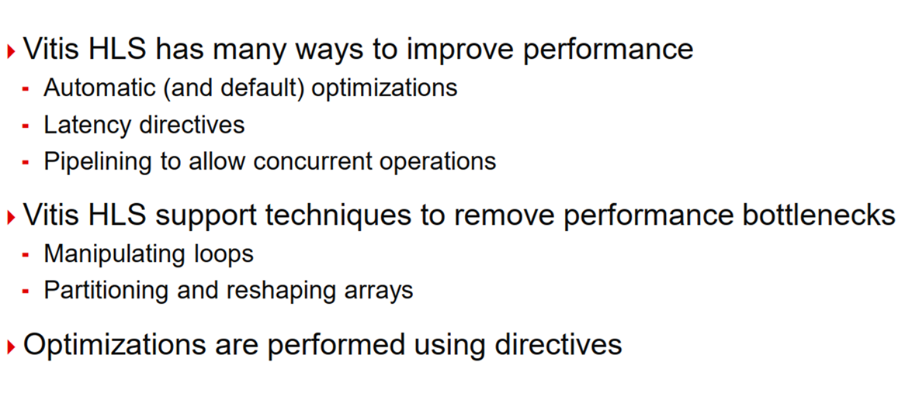
Improving Performance

Slide 4
Improving Throughput
Pipeline & dataflow

Slide 5
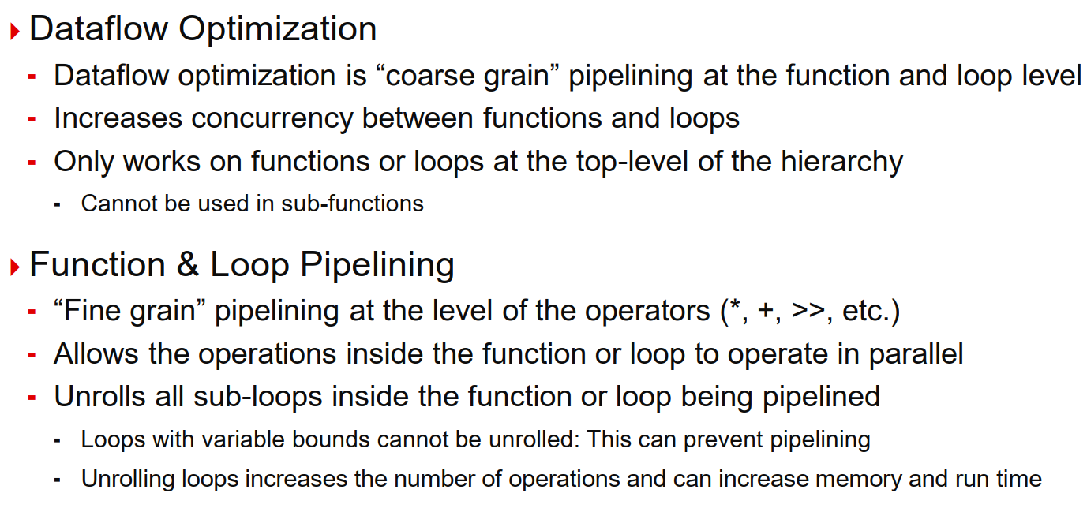
Dataflow vs Pipelining Optimization

Slide 6
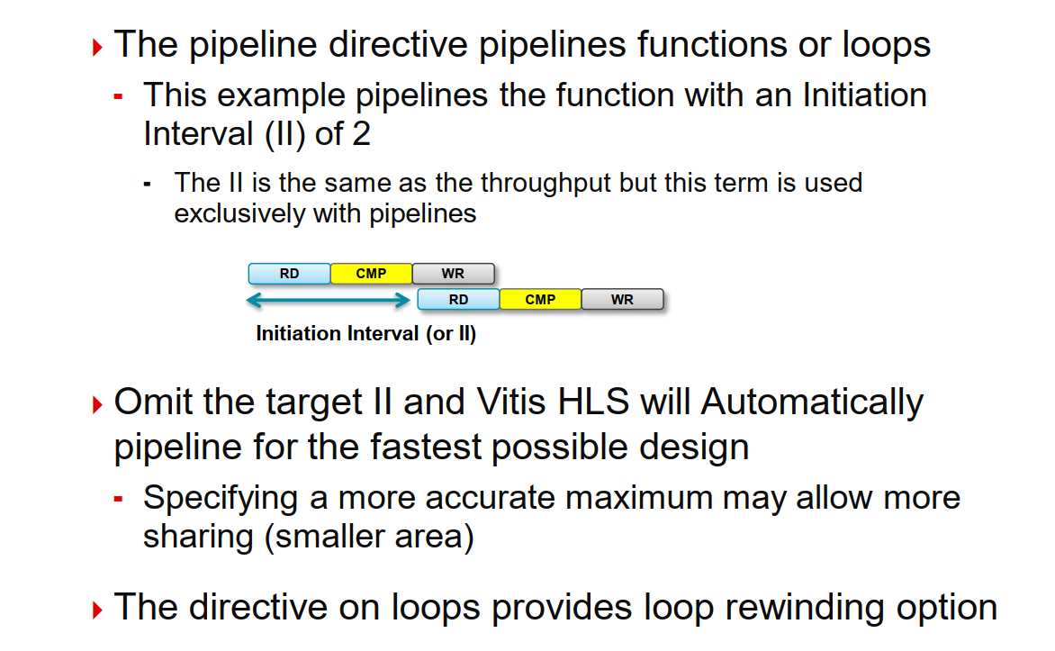
Pipeline Directive

Slide 7
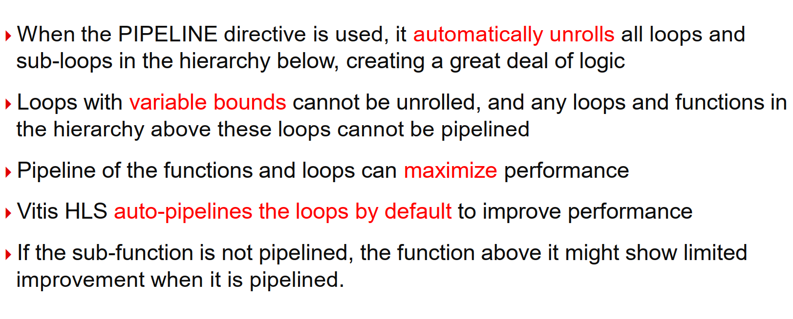
Pipeline for Performance

Slide 8
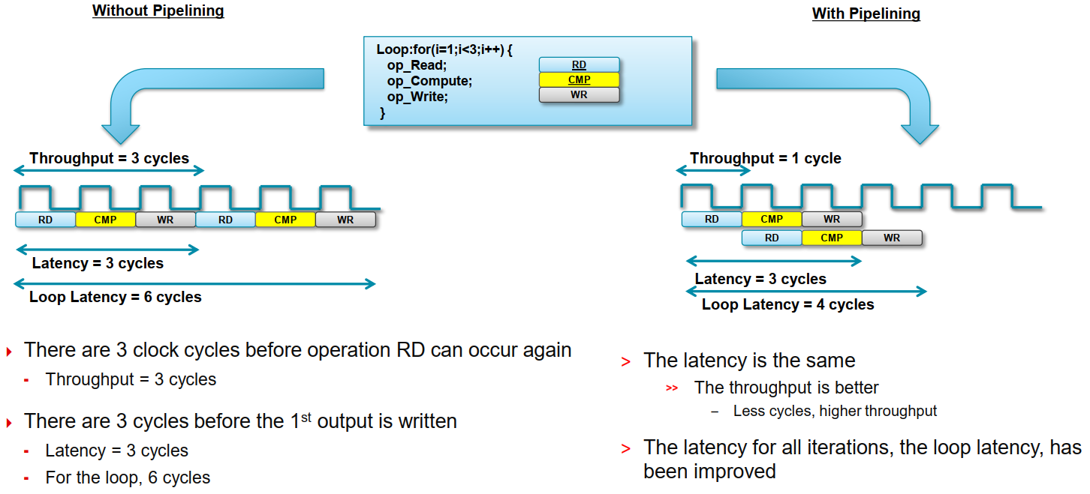
Loop Pipelining

Slide 9
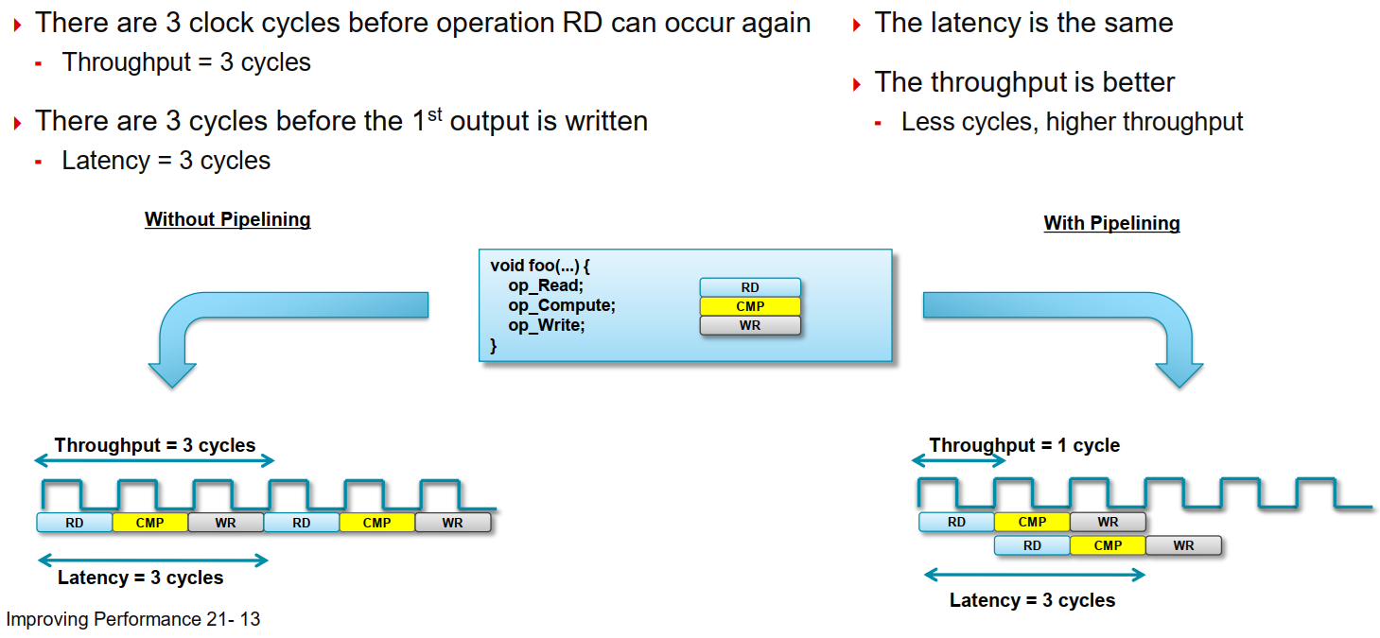
Function Pipelining

Slide 10
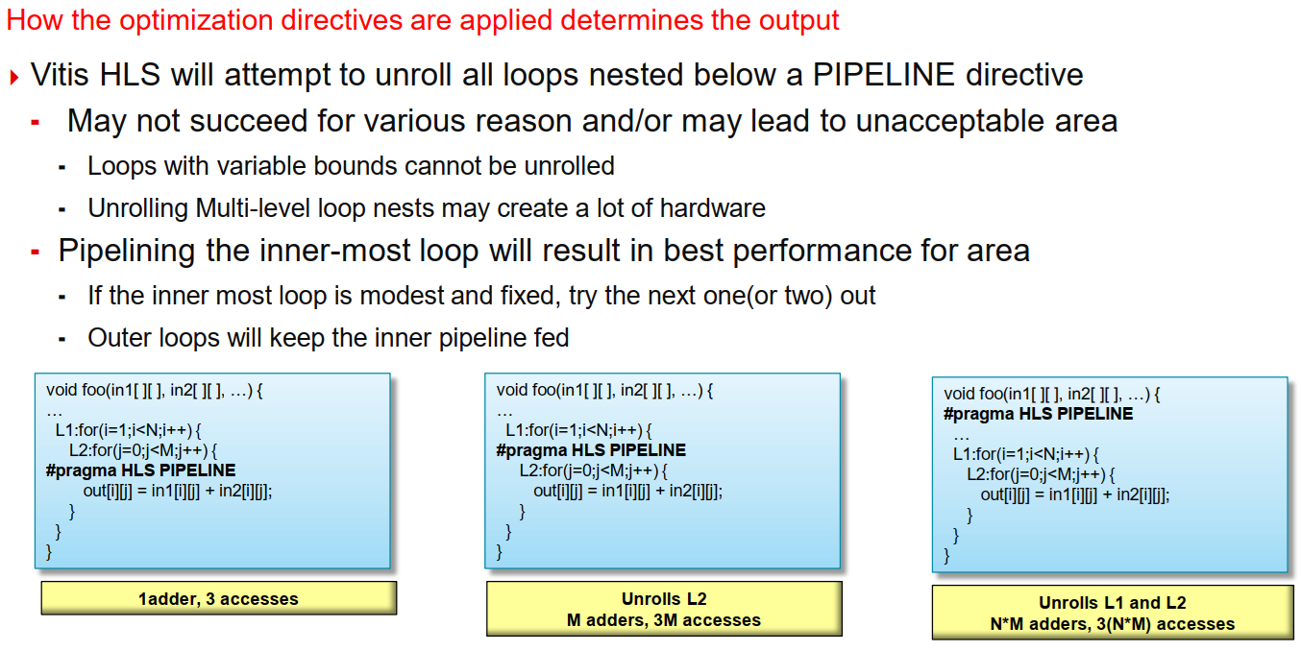
Pipelining: Be Careful Where You Put it

Slide 11
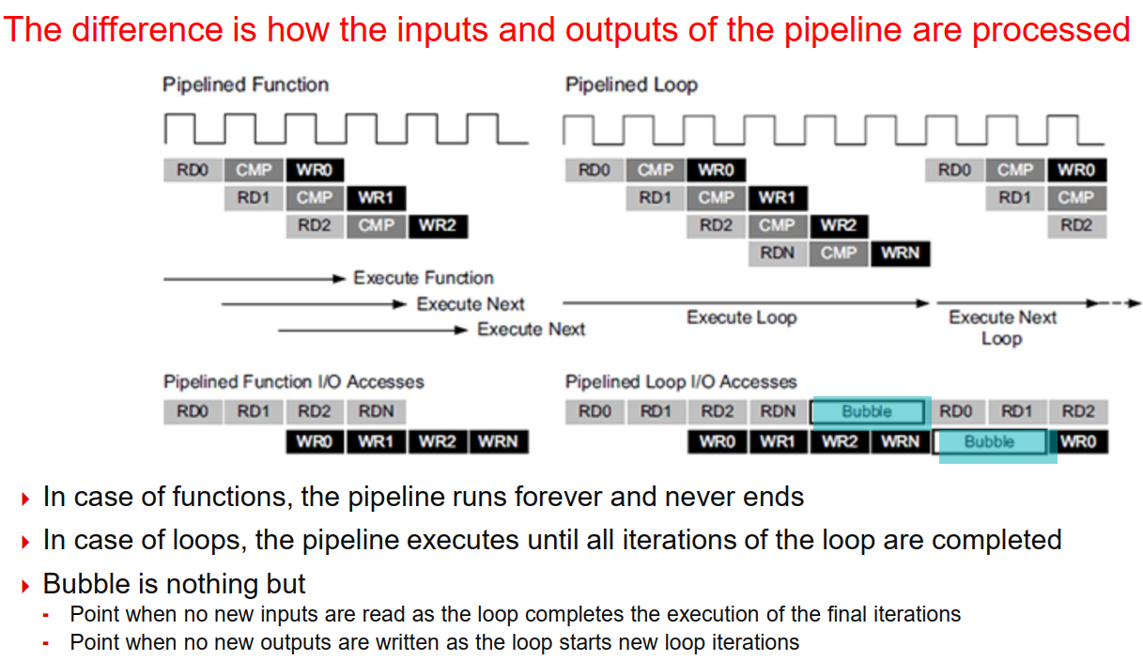
Pipelined Functions and Loops

Slide 12
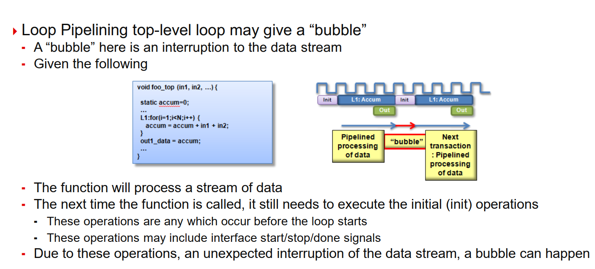
Pipelining the Top-Level Loop

Slide 13
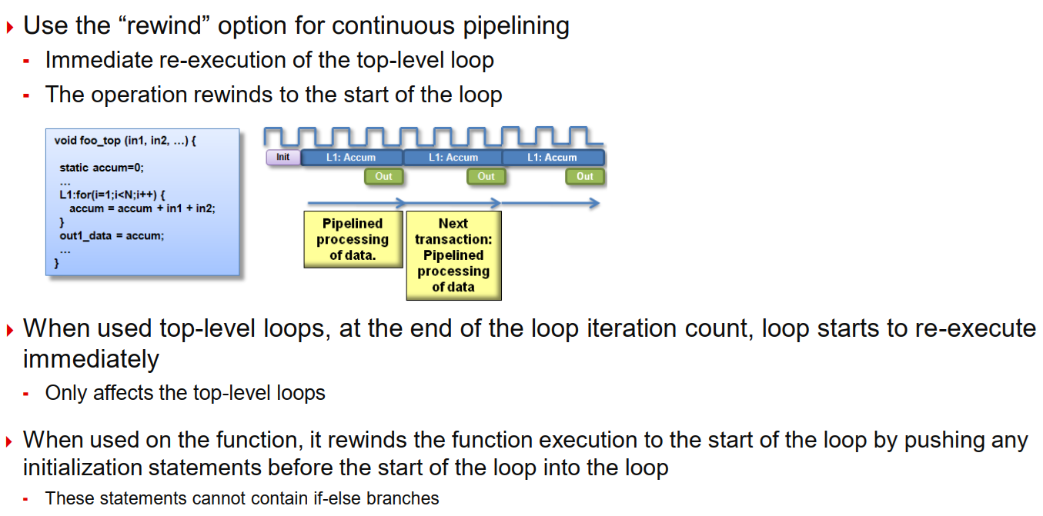
Continuous Pipelining the Top-Level loop

Slide 14
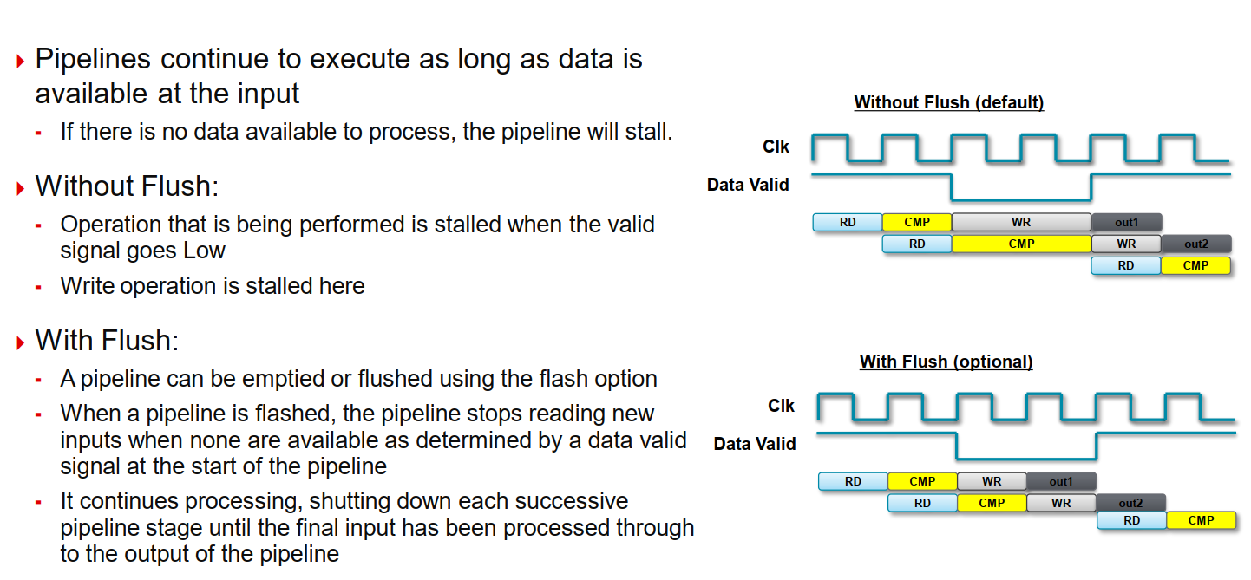
Pipeline Flush

Slide 15
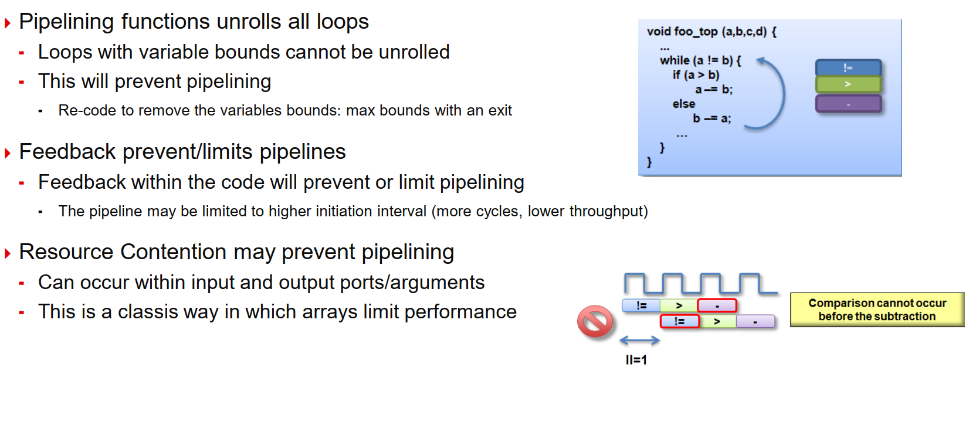
Issues That Prevent Pipelining

Slide 16
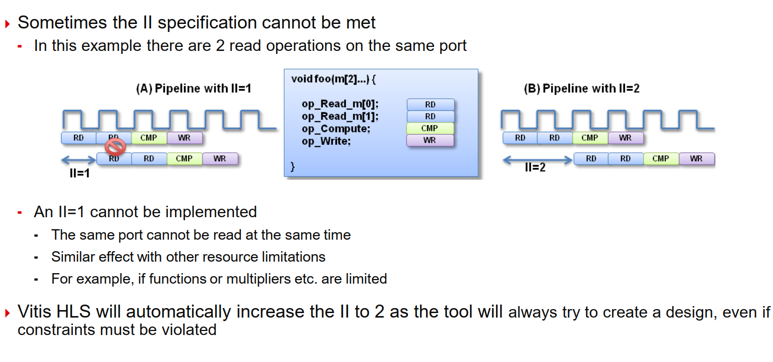
Resource Contention: Unfeasible Initiation Intervals

Slide 17
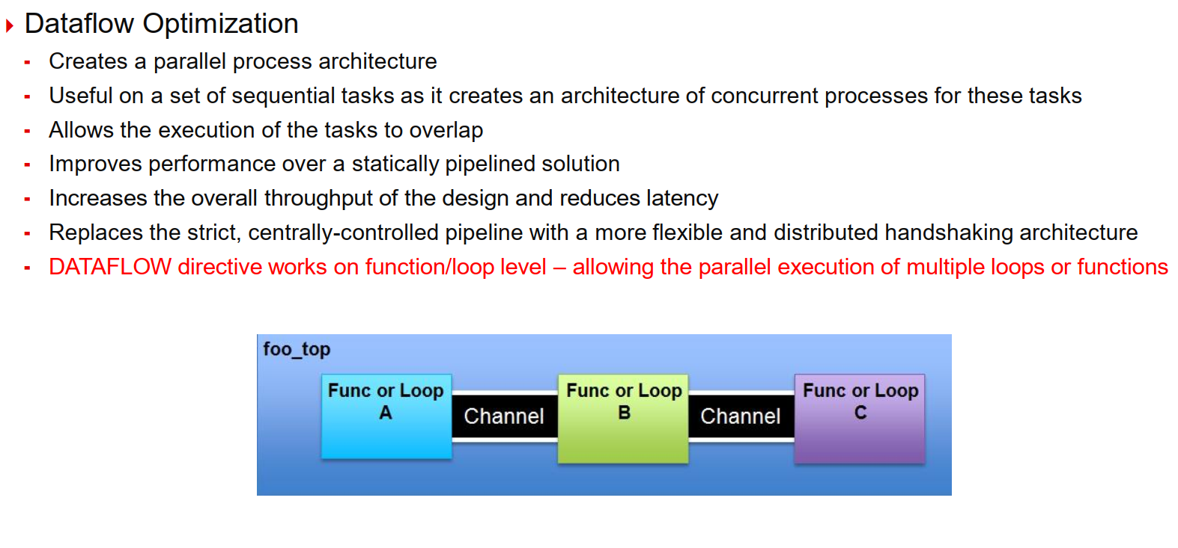
Dataflow Optimization

Slide 18
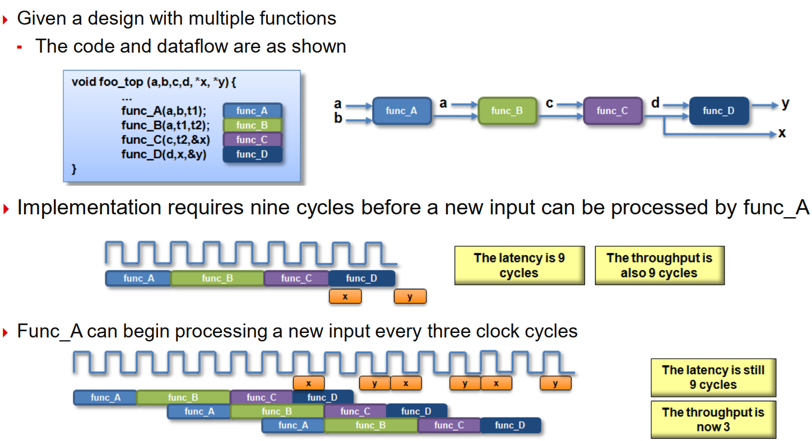
Dataflow for Performance

Slide 19
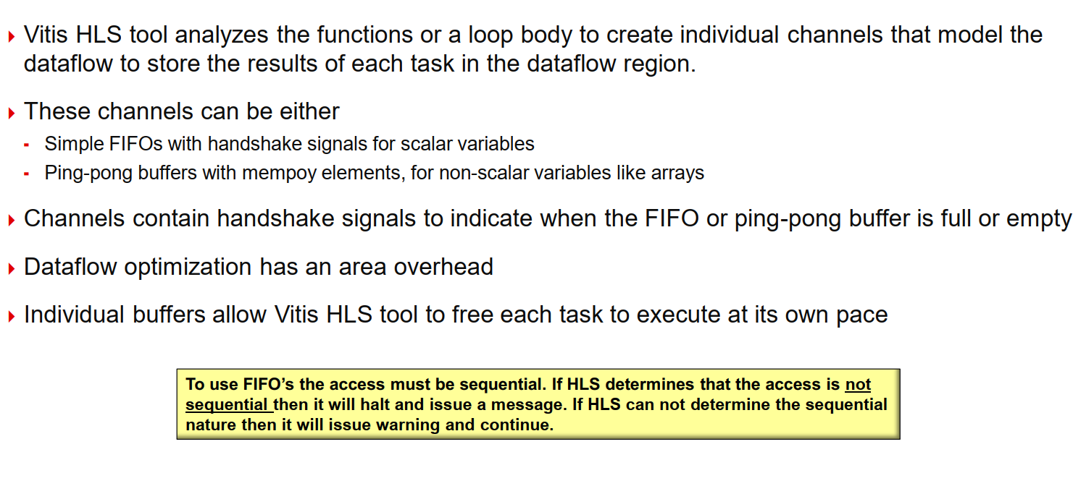
Configuring the Dataflow Channel

Slide 20
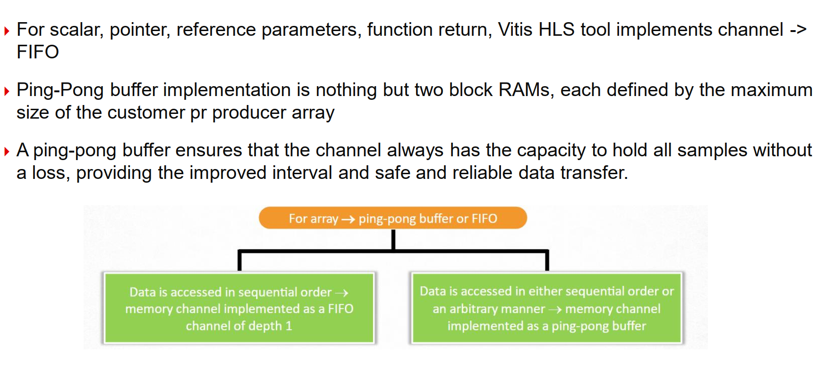
FIFO vs Ping-Pong Buffer

Slide 21
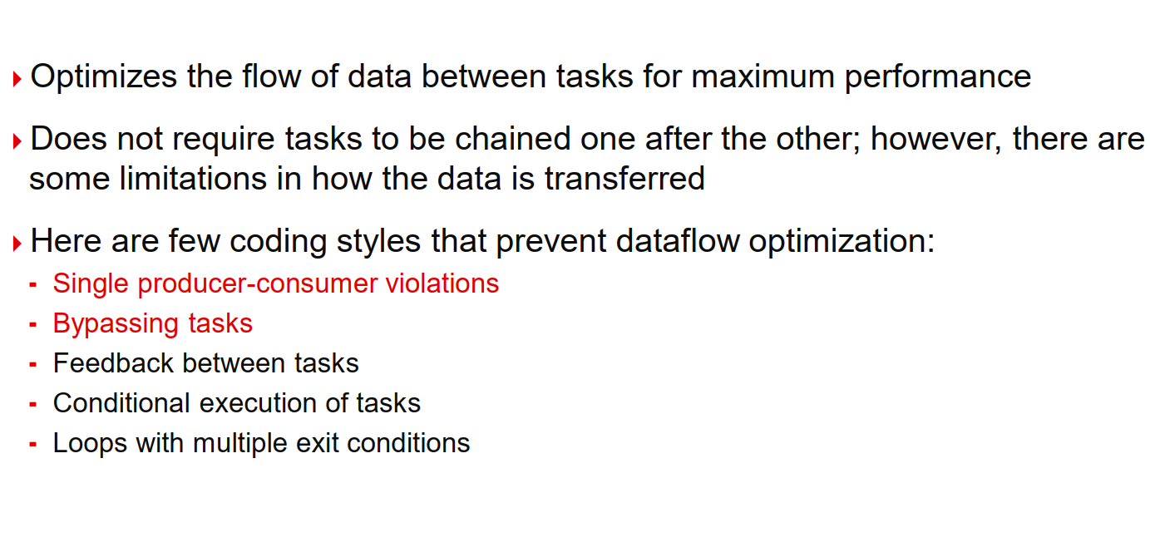
Dataflow Optimization Limitations

Slide 22
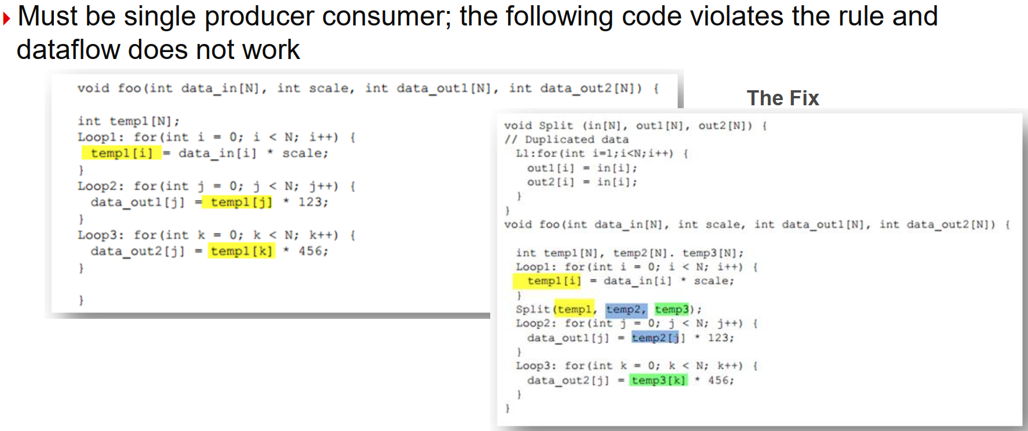
Single producer-consumer violations

Slide 23
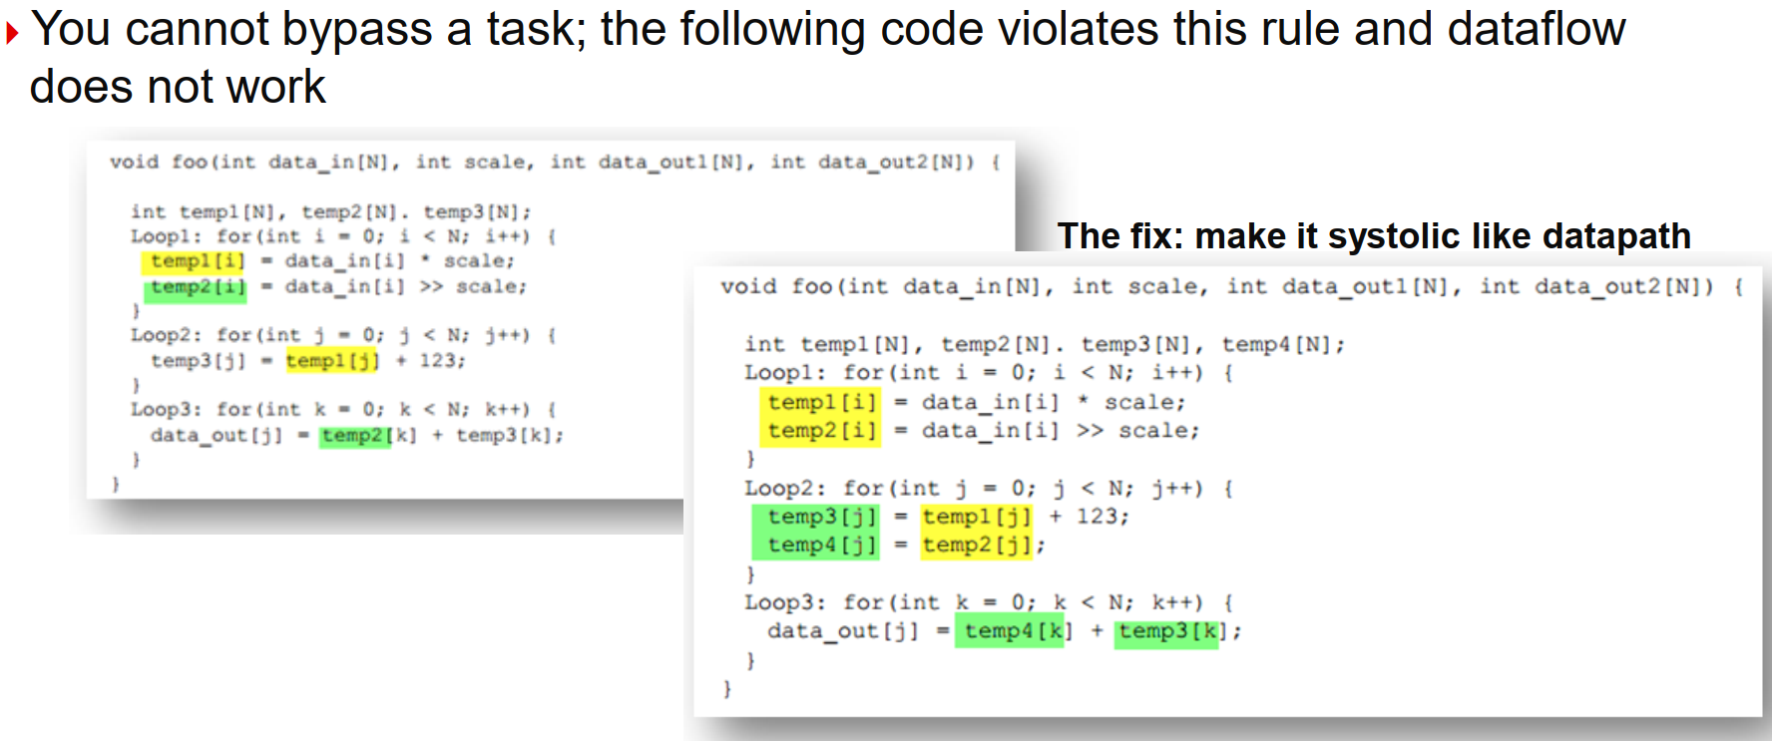
Bypassing Tasks

Slide 24
Optimize for throughput
Performance Bottleneck

Slide 25
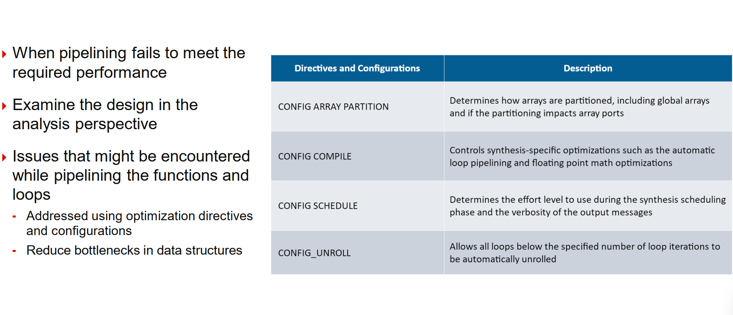
Optimize for throughput

Slide 26
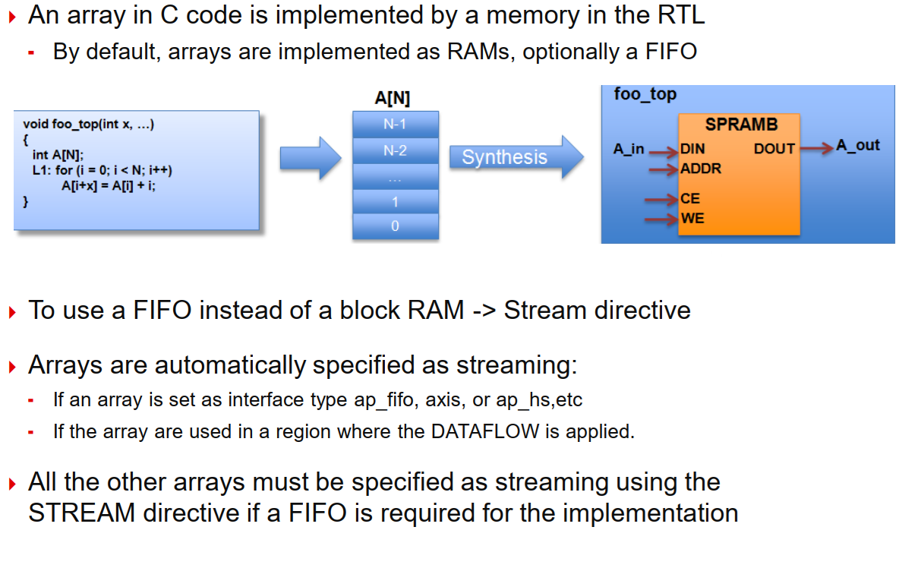
Review: Arrays in HLS

Slide 27
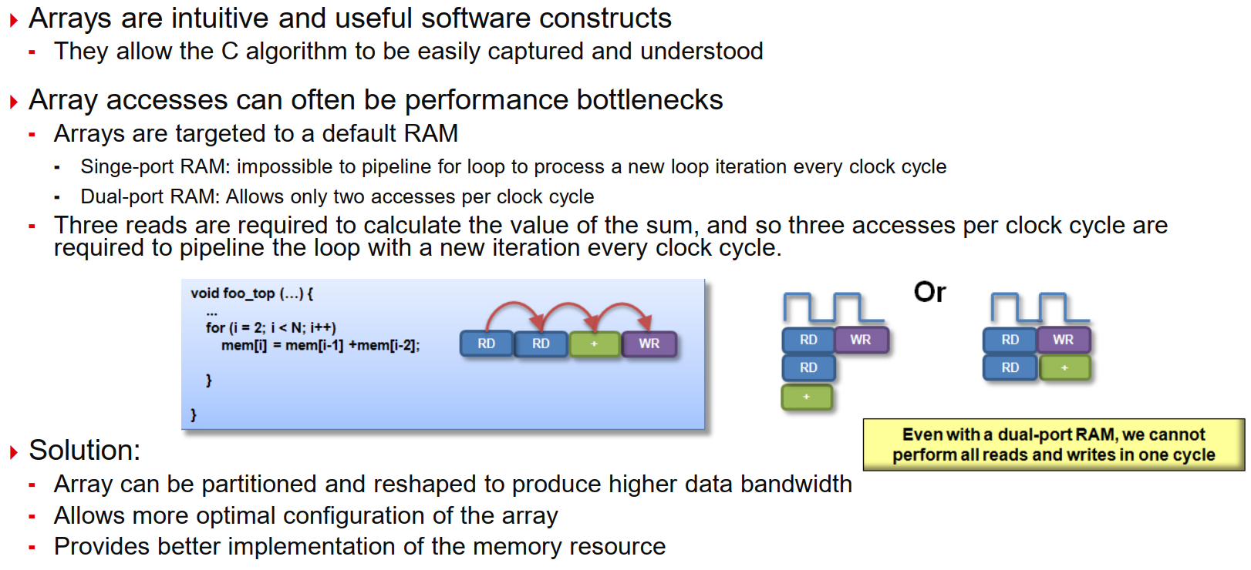
Arrays : Performance bottlenecks

Slide 28
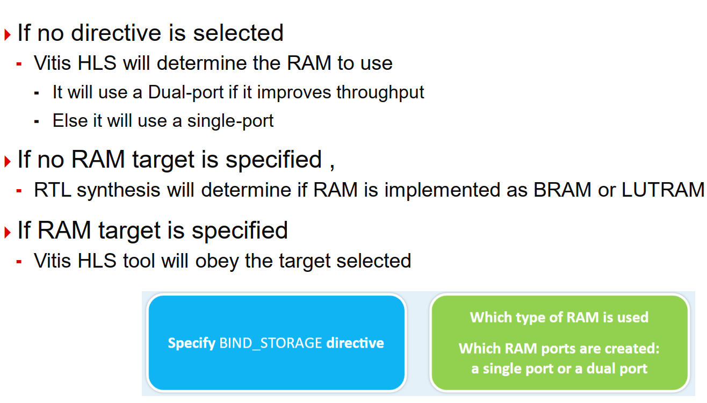
Array and RAM selection

Slide 29
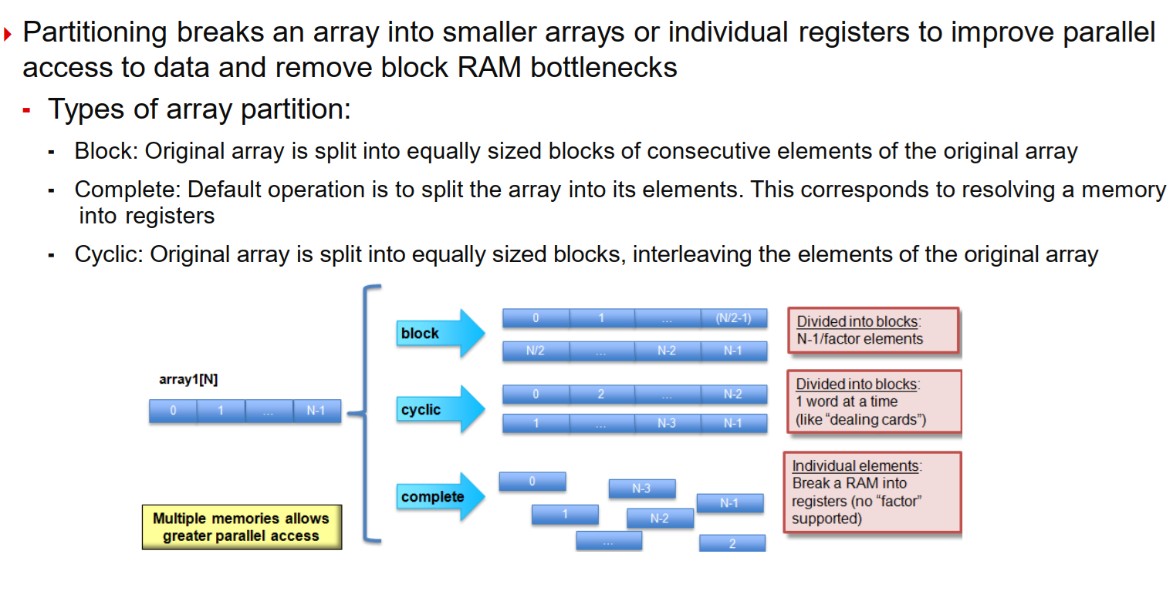
Array Partitioning

Slide 30
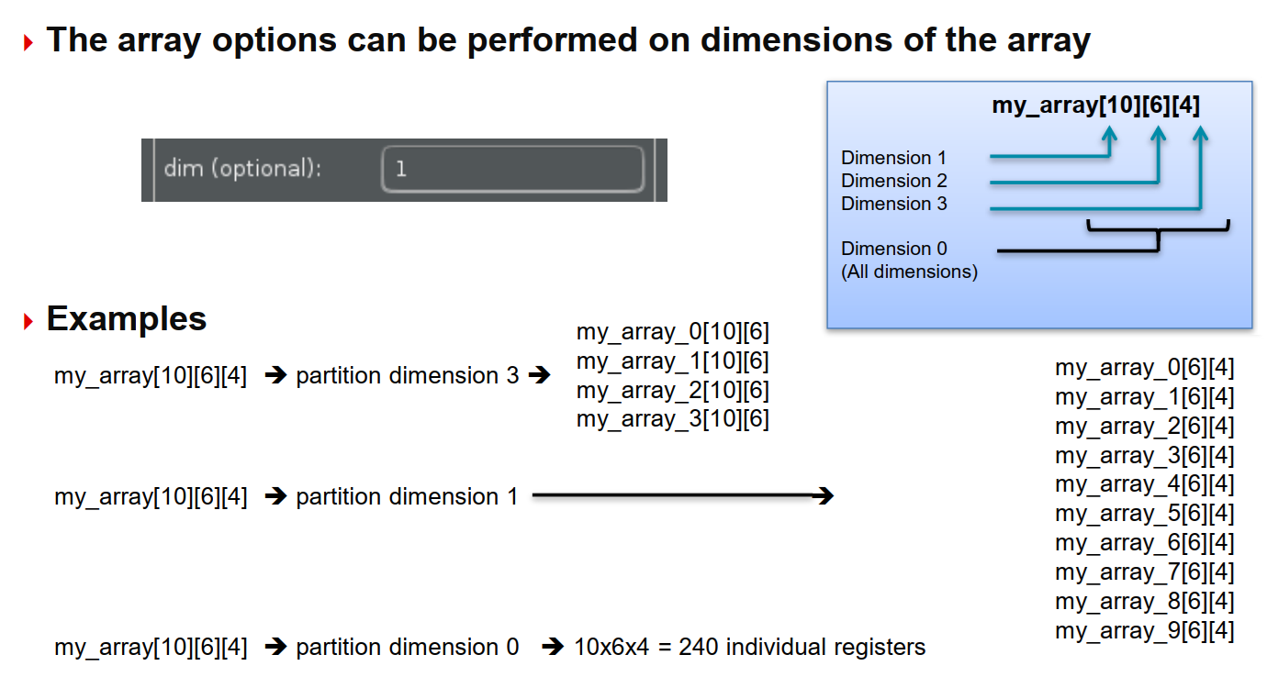
Array Dimensions

Slide 31
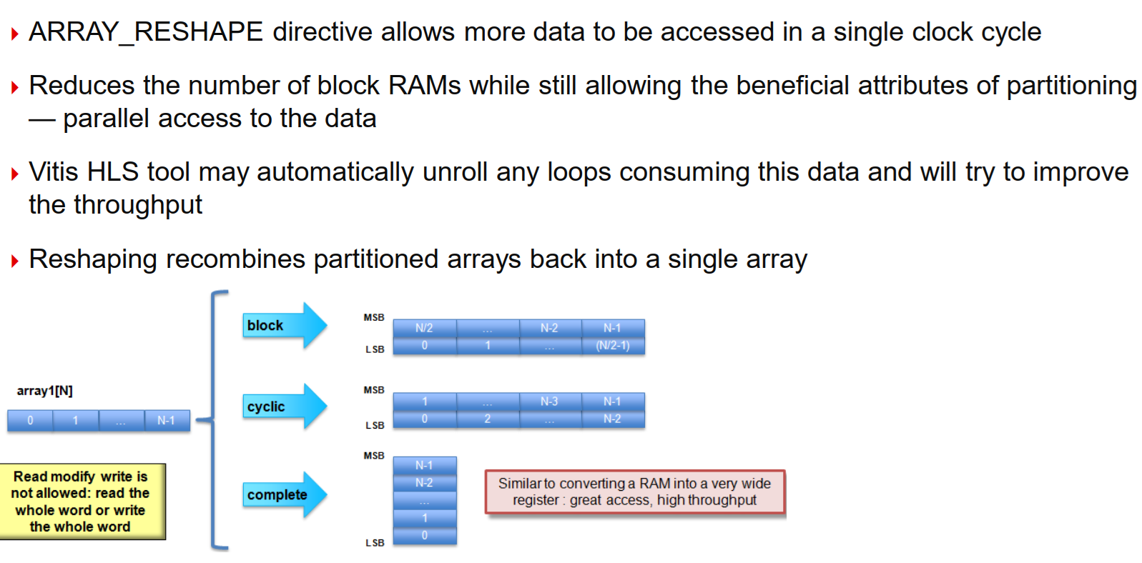
Array Reshaping

Slide 32
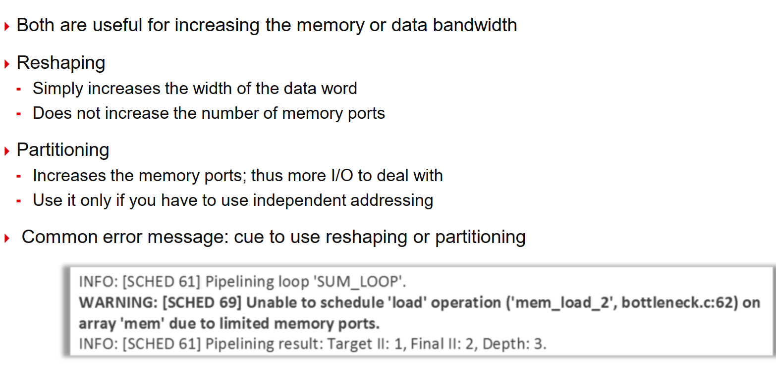
Reshaping vs Partitioning

Slide 33
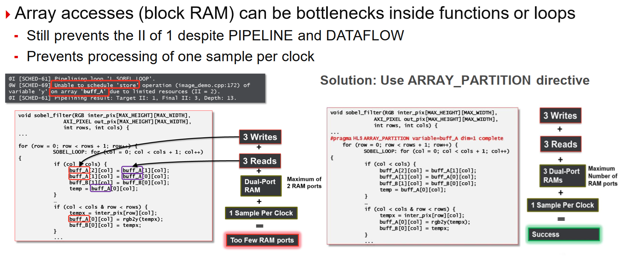
Bottleneck Example

Slide 34
Improving Latency

Slide 35
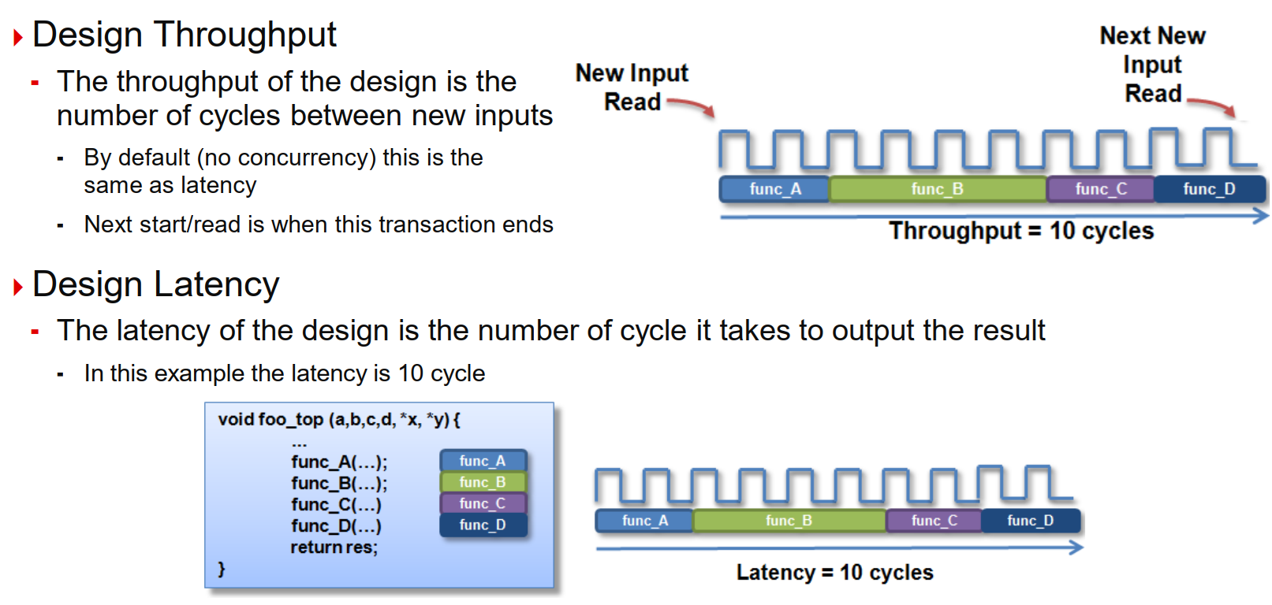
Latency and Throughput – The Performance Factors

Slide 36
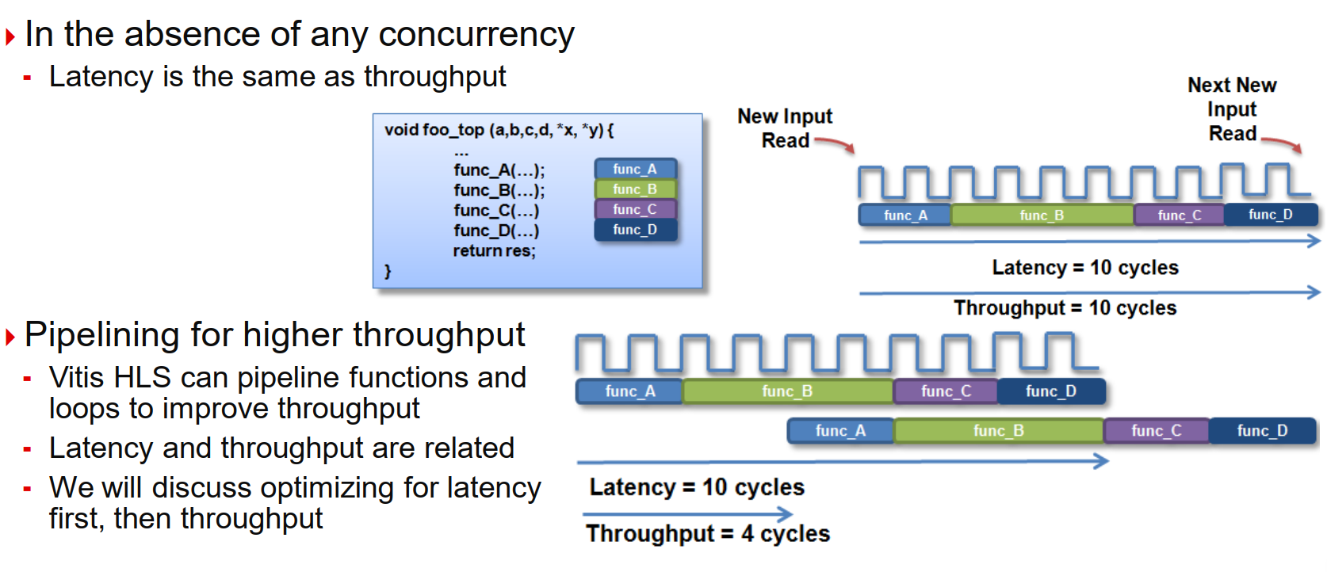
Latency and Throughput

Slide 37
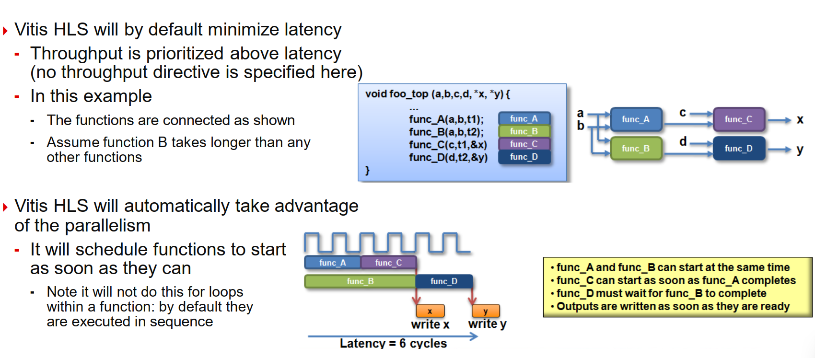
Vitis HLS: Minimize latency

Slide 38
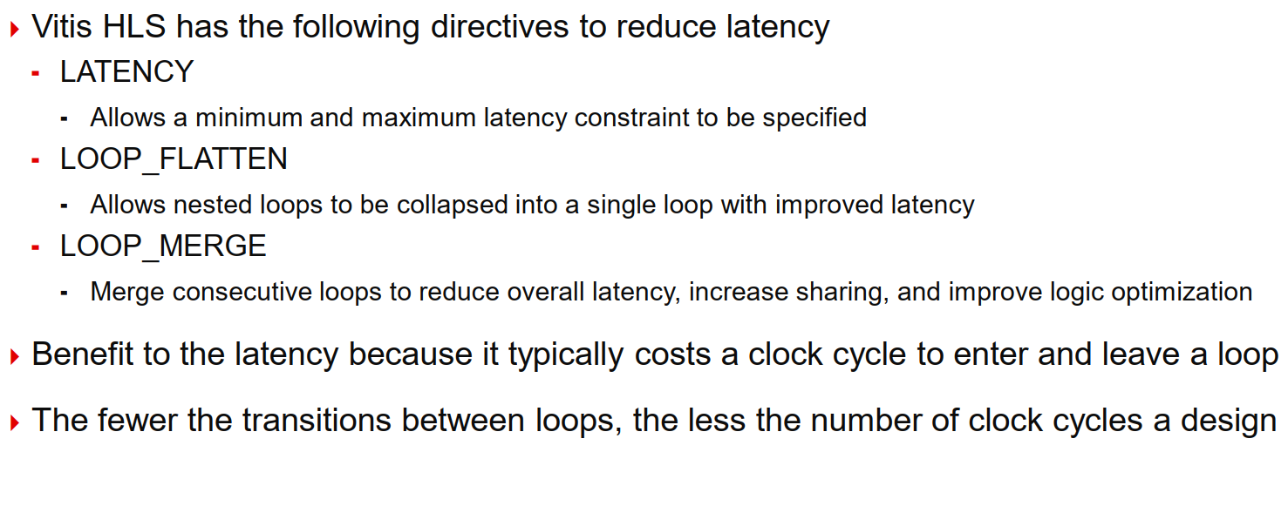
Reducing Latency

Slide 39
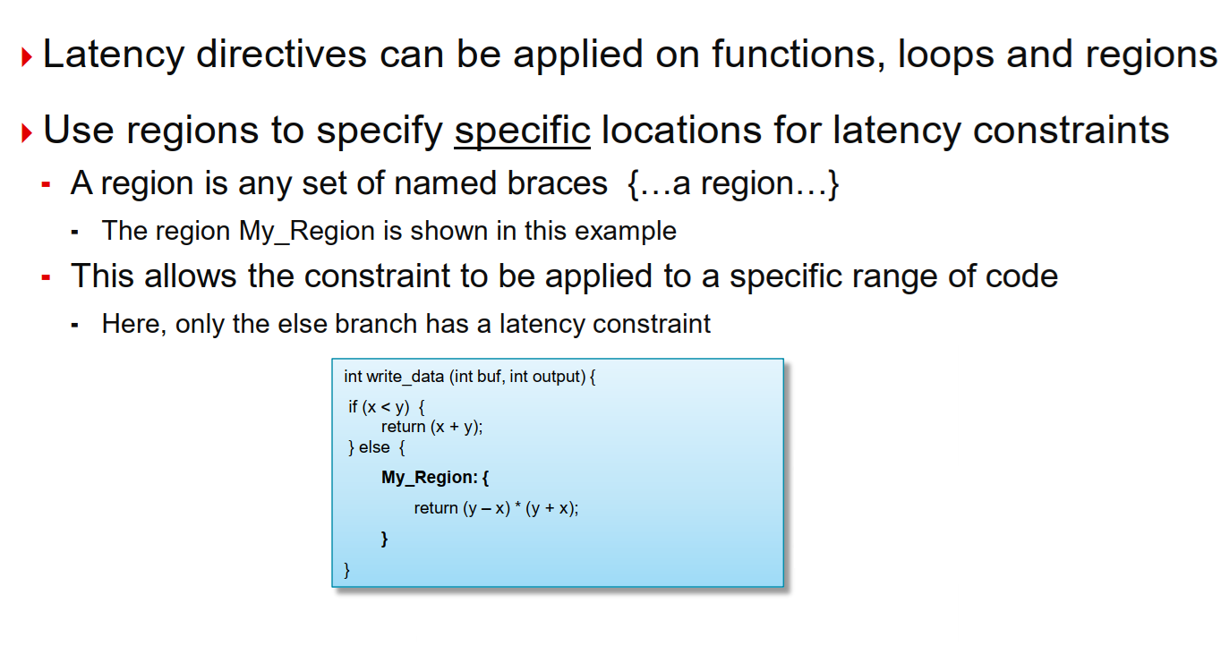
Region Specific Latency Constraint

Slide 40
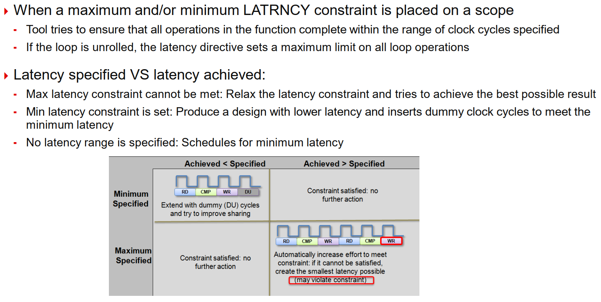
Latency Constraints

Slide 41
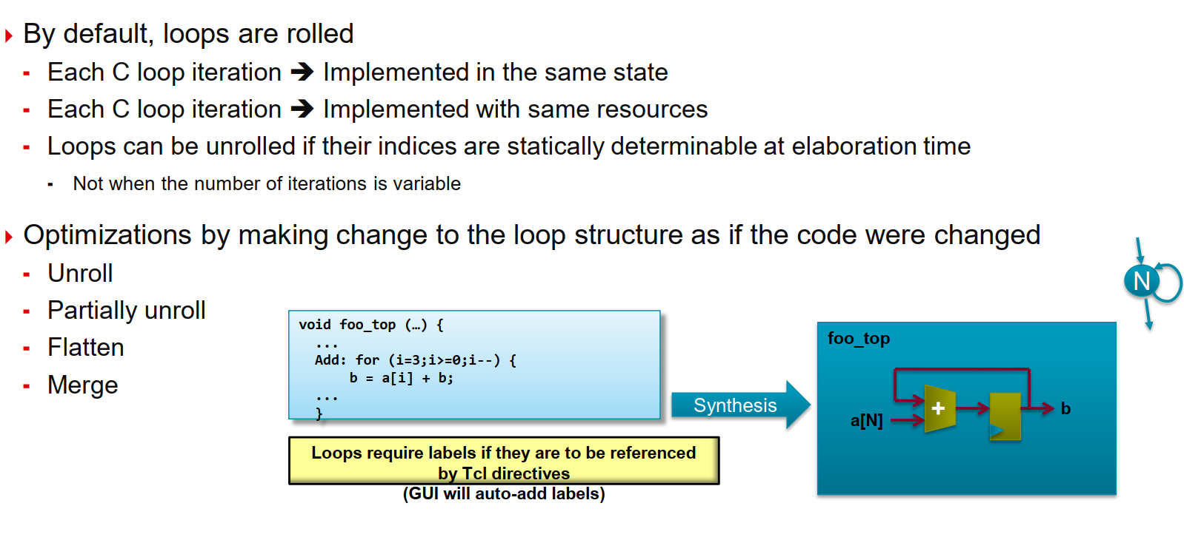
Review: Loops

Slide 42
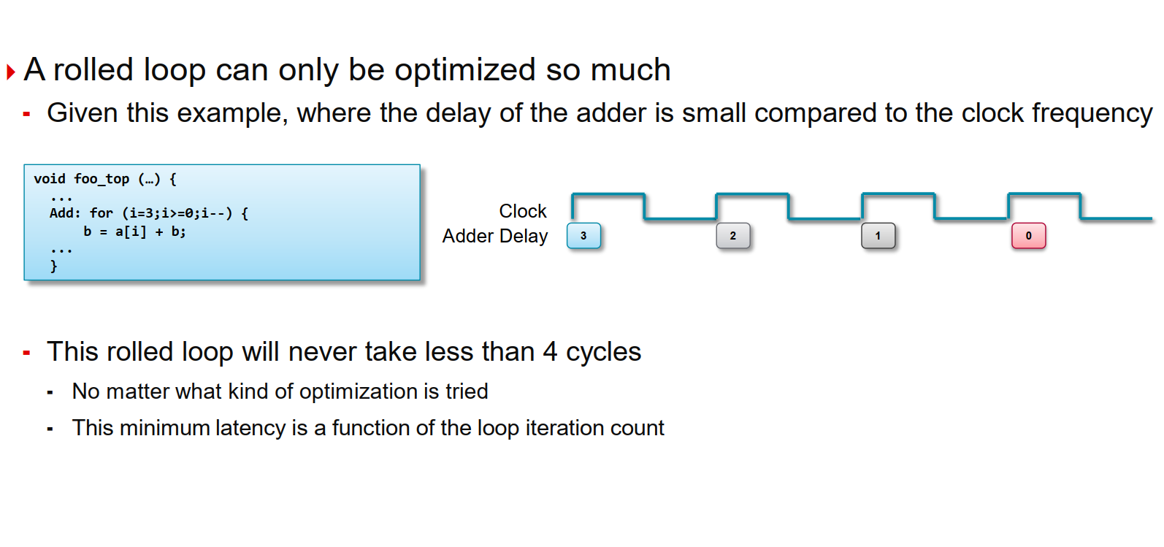
Rolled Loops Enforce Latency

Slide 43
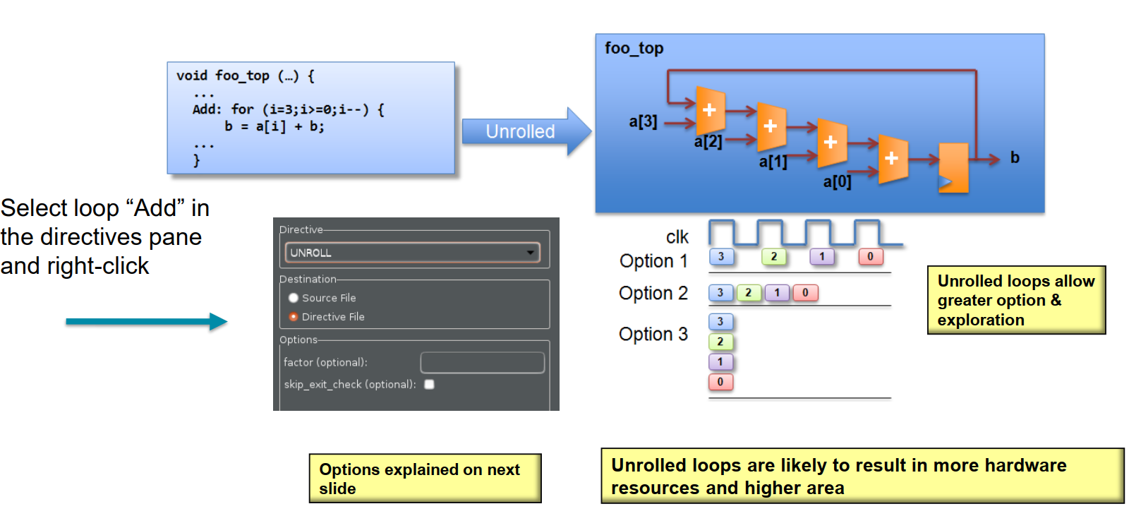
Unrolled Loops can Reduce Latency

Slide 44
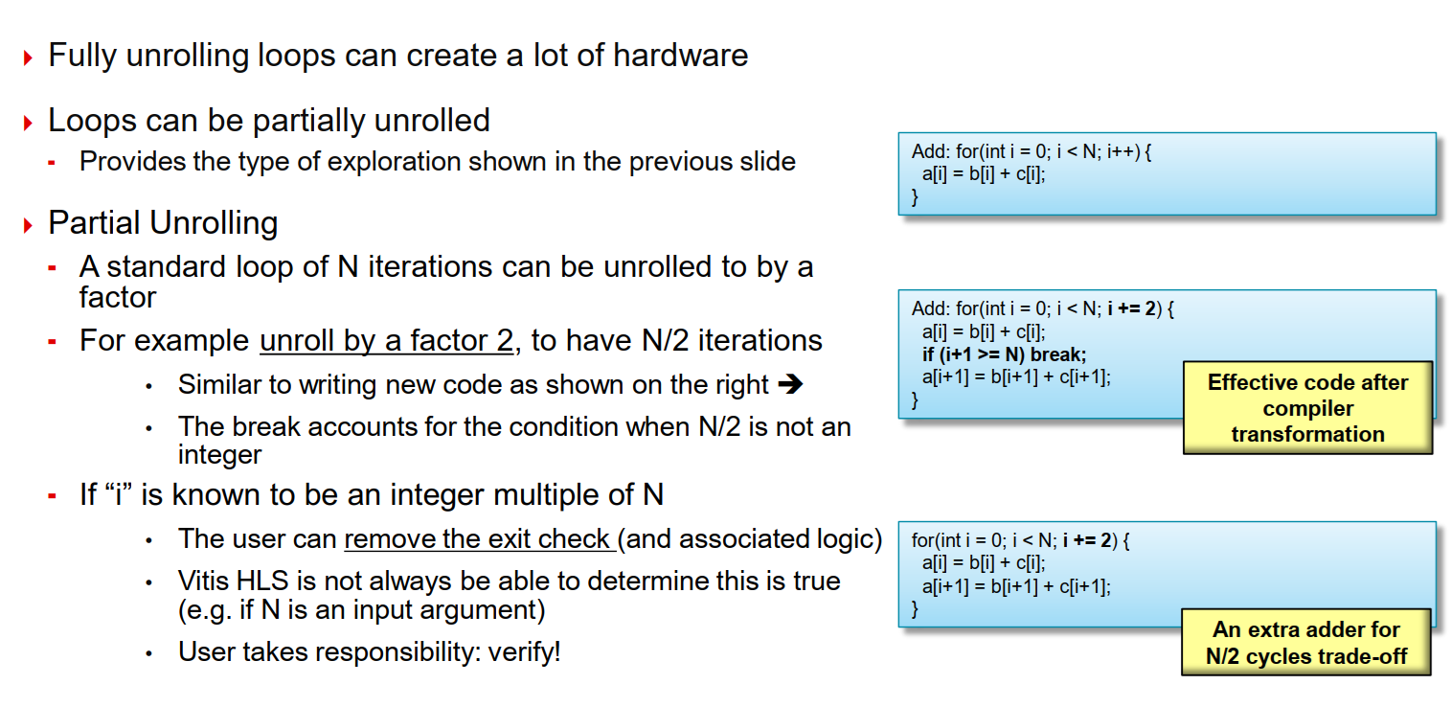
Partial Unrolling

Slide 45
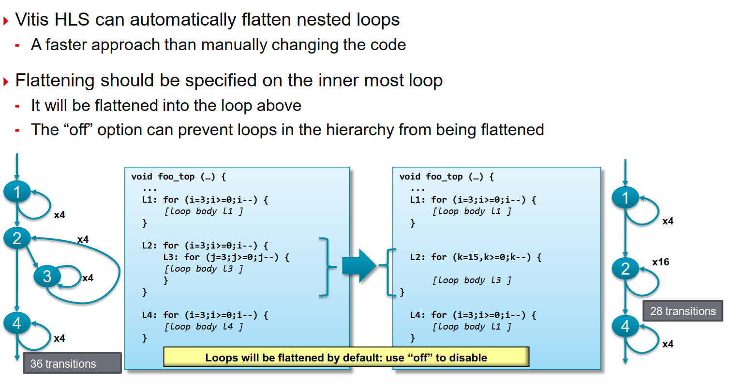
Loop Flattening

Slide 46
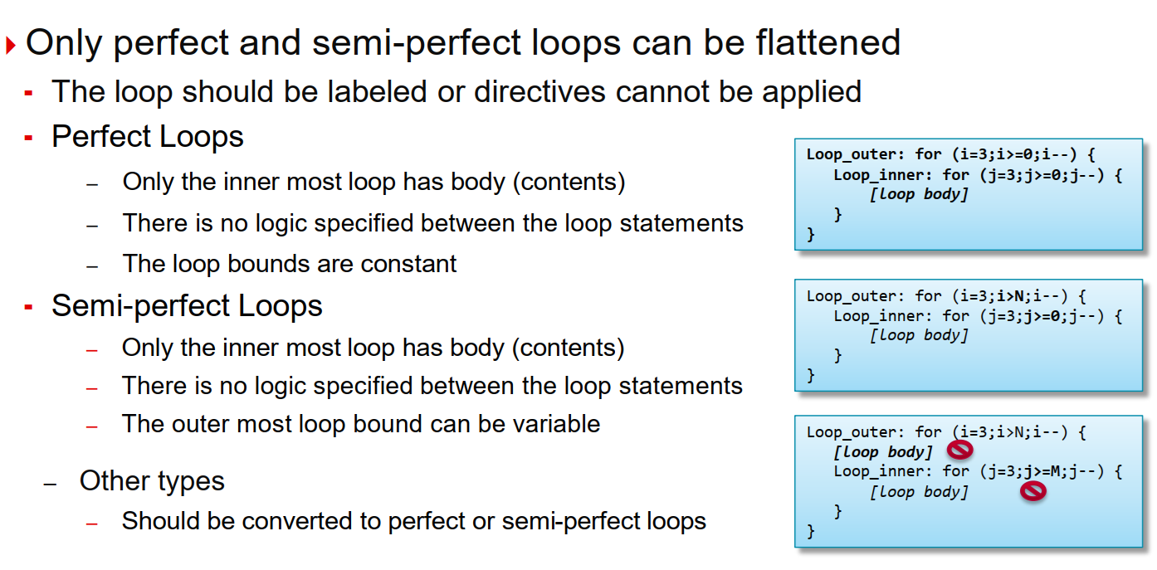
Perfect and Semi-Perfect Loops

Slide 47
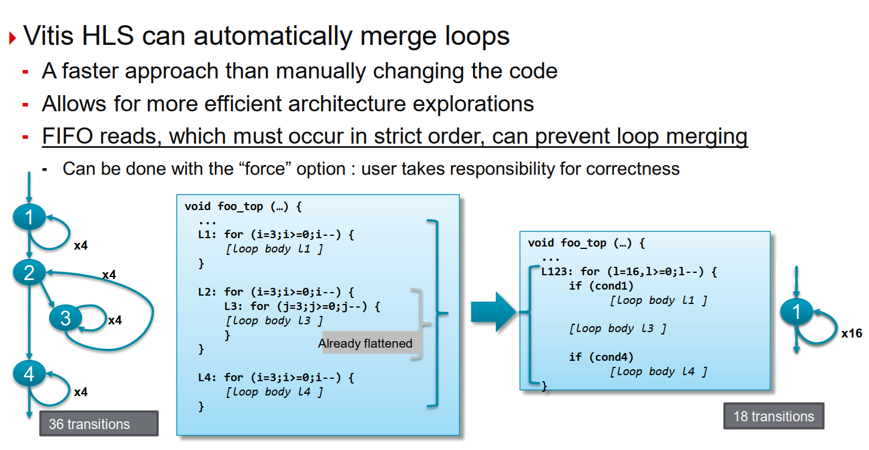
Loop Merging

Slide 48
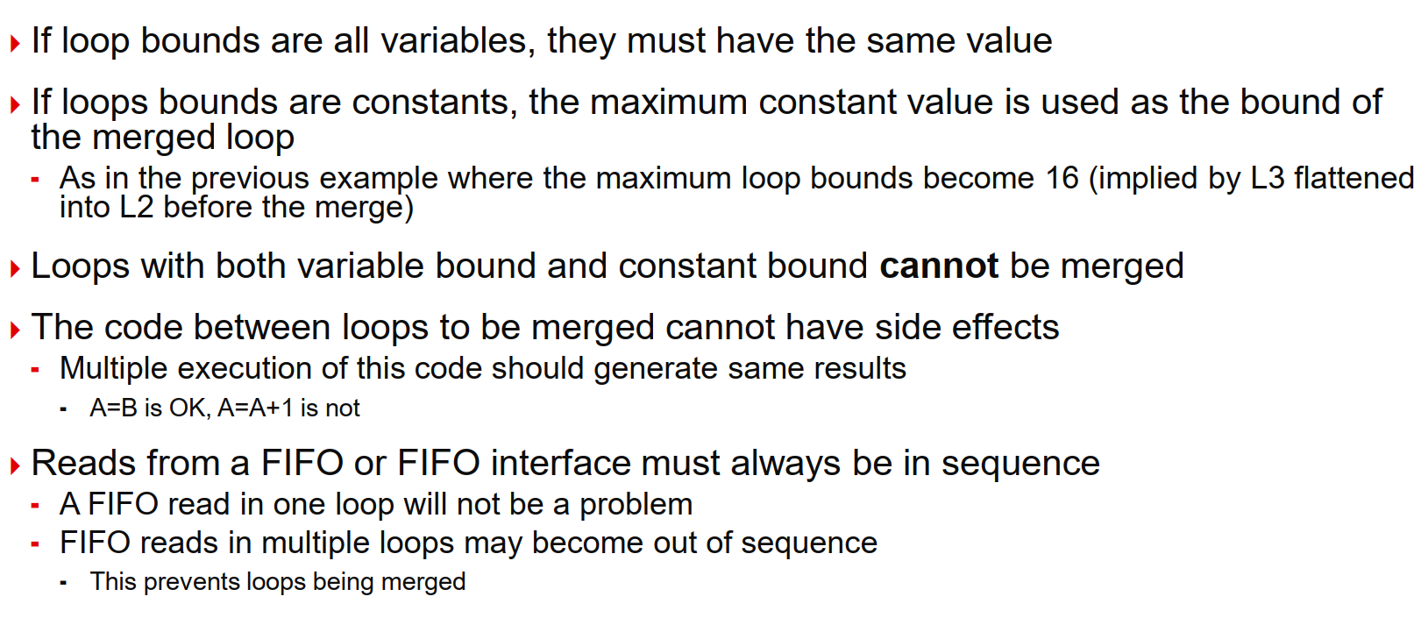
Loop Merge Rules

Slide 49
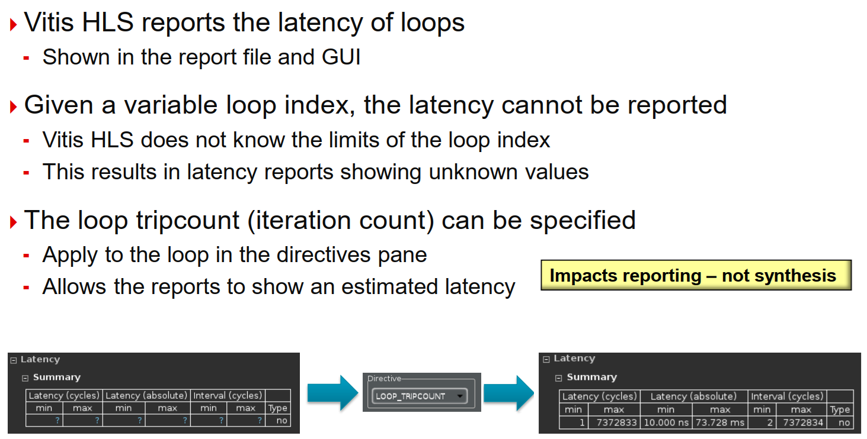
Loop Reports

Slide 50
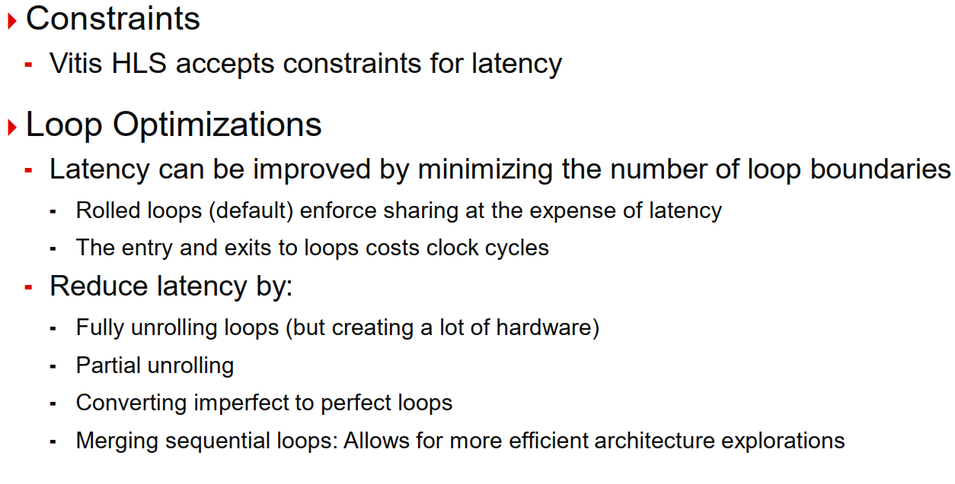
Techniques for Minimizing Latency - Summary

Slide 51
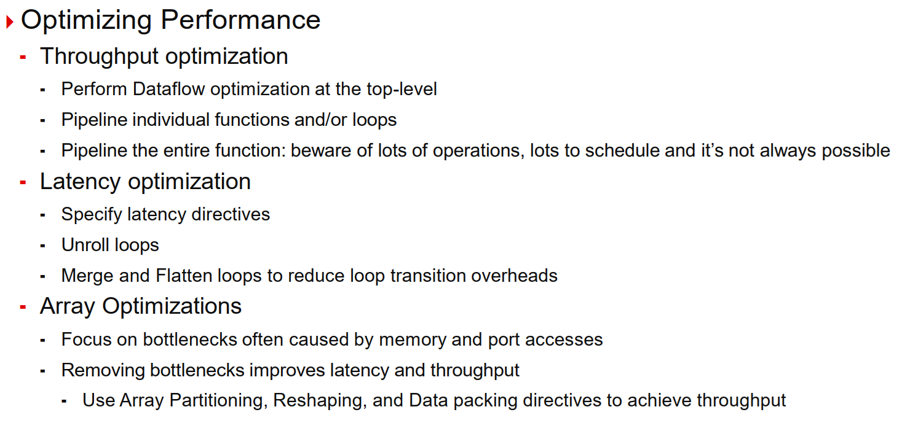
Summary

Slide 52
Lab-2
Improving Performance of matrixmul design

Slide 53
Task-1
Improving Performance of Image Processing Task

Slide 54
Procedure
Use the optimizations used in the lab-2 to improve the performance of the function imGrayscale()

Slide 55
Thanks

